Slide 1

Presentation on
Enhancing Clinical Interpretability in Brain Tumor Diagnosis: A Deep Learning Framework with Explainable AI
Under the Course of
Course Title: Thesis or Project work
Course Code: CSE-499(B)
Prepared by ,
Sadia Akter
ID :0322210205101127
Semester:8th
Batch :20th
Session :Spring-22
Supervisor ,
Md. Forhan Shahriar Fahim
Lecturer
Dept. of CSE

Slide 2
Outlines
Introduction
Objectives
Related work
Methodology
Dataset
Model Architecture
Training and validation performance
Confusion matrix
Classification report
Explainable AI using Grad-CAM
Comparative analysis
Conclusion and future works
Reference

Slide 3
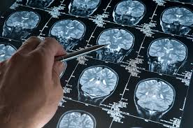
Introduction
Brain tumor diagnosis is critical and often delayed in developing countries.
Manual MRI analysis is slow and depends on limited expert radiologists.
Transfer learning–based CNNs enable accurate automated classification.
XAI (Grad-CAM) improves interpretability and clinical trust.
This work aims to support early detection and better decision-making.
Figure 1: AI detects brain tumors

Slide 4
Objectives
1. To design a VGG16-based CNN for brain tumor classification.
2. To classify MRI brain images into multiple categories with high accuracy.
3. To evaluate the performance of the proposed model using standard confusion matrix.
4. To use Grad-CAM for model interpretability.
5. To support brain tumor diagnosis in resource-limited settings.

Slide 5
Related Works
Author(year) | Model | Tumor Classes | Accurecy (%) | Limitation
Zhang et al.(2018)[1] | VGG16(Transfer Learning) | Multiclass | 96.0 | Reduced precision for pituitary tumors, no XAI integration
Abdel- Basset et al.(2020)[2] | Custom CNN+ Handcrafted Features | Glioma , Meningioma | 98.0 | Large model size, explainability not included
Chowdhury et al.(2021)[3] | CNN-LSTM Hybride | Multiclass | 97.9 | Increased complexity, longer training time, limited dataset diversity

Slide 6
Related Works
Author(year) | Model | Tumor Classes | Accurecy (%) | Limitation
Patel et al.(2020)[4] | CNN + Attention Mechanism | Glioma , Meningioma , Pituitary | 98.2 | No Grad-CAM/XAI, visual interpretability missing
Sharma et al.(2020)[5] | ResNet50, InceptionV3, Custom CNN | Multiclass | 98.5 | Small class subsets underperformed, no XAI
Haque & Islam (2021)[6] | VGG16 (No selective fine-tuning) | Multiclass | 98.5 | Lack of explainability, limited data augmentation

Slide 7
Related Works
Author(year) | Model | Tumor classes | Accurecy (%) | Limitation
Jain et al.[7] | Custom Deep CNN | Multiclass | ~96.8 | Overfitting, limited data diversity, unstable class-wise performance
Kaur et al. (2021)[8] | ResNet50, DenseNet121, MobileNetV2 | Multiclass | 98.1 | No XAI integration, interpretability limited
Patel & Shah (2019)[9] | InceptionV3 | Multiclass | 97.9 | High model complexity, no explainability

Slide 8
Related Works
Author(year) | Model | Tumor classes | Accurecy (%) | Limitation
Roy et al.(2021)[10] | Feature Fusion + ML | Glioma vs Meningioma | 98.0 | Poor generalization for pituitary & normal classes, no transfer learning
Verma et al.(2022)[11] | Cascaded CNN | Multiclass | 98.3 | High computational cost, no XAI

Slide 9
Methodology
Automated, explainable deep learning framework using VGG16 + Grad-CAM to classify glioma, meningioma, pituitary, and no tumor from MRI, supporting accurate and interpretable clinical decisions
Data Acquisition
Data Preprocessing
Data Augmentation
Load Pretrained VGG16
Custom Classification Head
Grad-CAM Explainability
Prediction & Evaluation
Fine-Tuning
Model Training
Visualization
Figure 2 : Workflow diagram of proposed system

Slide 10
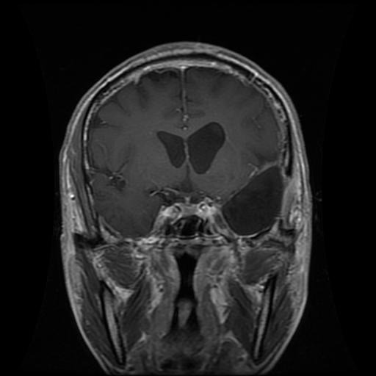
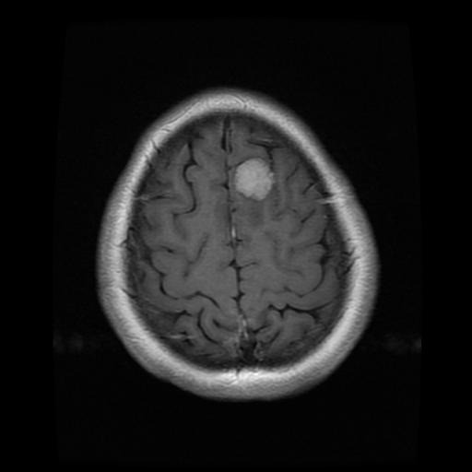
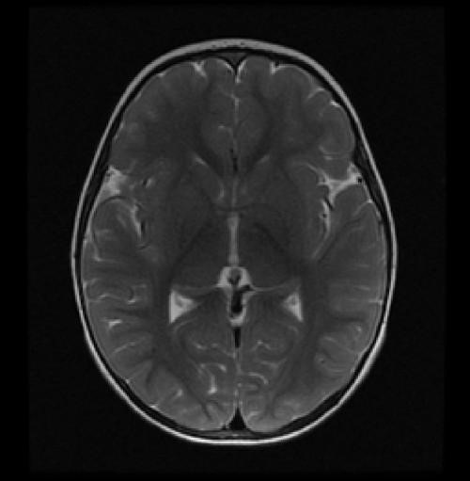
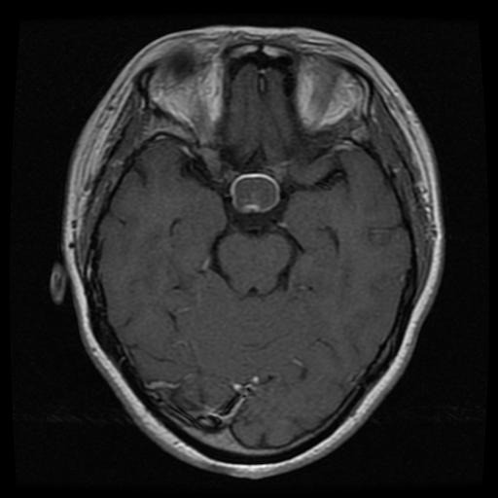
Dataset Description
Dataset :
The dataset used in this study is the Brain Tumor MRI Dataset collected from Kaggle of masoud nick parvar brain tumor-mri-dataset.[12]
Classes :
This dataset contains four classes related to brain tumors,
Glioma
Meningioma
No Tumor
Pituitary

Slide 11
Dataset distribution:
4,571 images
1,311 images
1,141 images
Training set
Validation set
Testing set
Figure 3: Dataset distribution

Slide 12
Model Architecture
Input Image
( 224 x 224 x 3)
VGG16 Base
(Pre- trained)
Custom Layers
Output Layer
Conv Layers
Flatten
Max Pooling
Dense Softmax
Dense 512 ReLU
Block5 Conv3
Brain Tumor Classes
Glioma
Meningioma
No tumor
Pituitary
Batch Normalization
Dropout 50%
Dense 512 ReLU
Dropout 40%
Figure 4: VGG16 model architecture

Slide 13
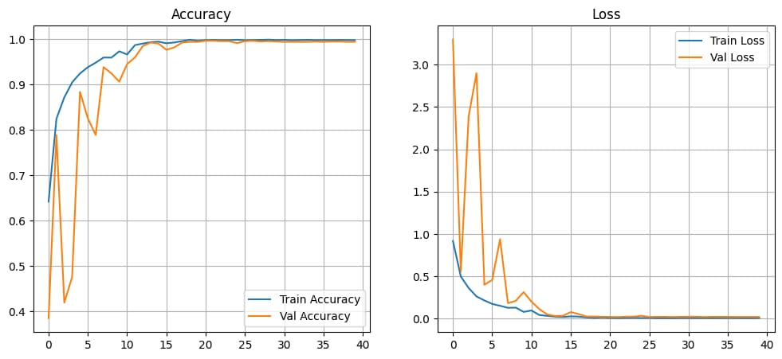
Training and validation performance
Figure 5: Training and Validation Accuracy and Loss Curve

Slide 14
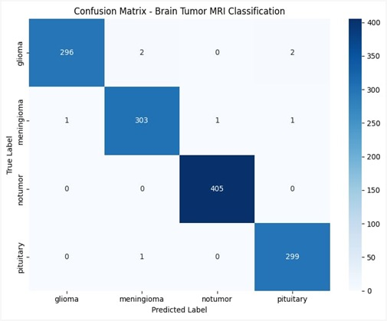
Confusion Matrix
Figure 6 : Confusion Matrix of Multiclass Brain Tumor Classification

Slide 15
Classification report
Class | precision | recall | f1-score | support
glioma | 1.00 | 0.99 | 0.99 | 300
meningioma | 0.99 | 0.99 | 0.99 | 306
notumor | 1.00 | 1.00 | 1.00 | 405
pituitary | 1.00 | 1.00 | 0.99 | 300
accuracy |  |  | 0.99 | 1311
macro avg | 0.99 | 0.99 | 0.99 | 1311
weighted avg | 0.99 | 0.99 | 0.99 | 1311

Slide 16
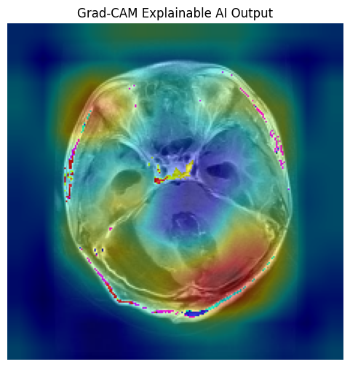
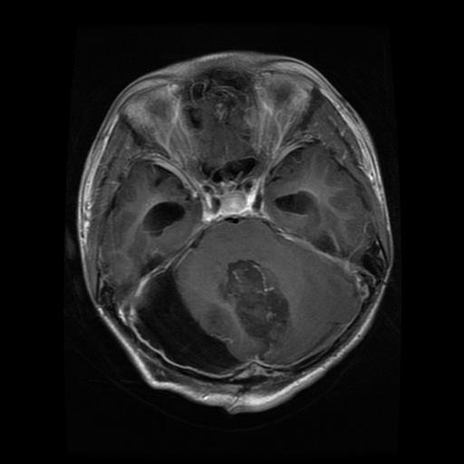
Explainable AI using Grad-CAM
MRI Image
Figure 7 : Grad-CAM Explainable AI Output

Slide 17
Comparative Analysis
Author (Year) | Model/Approach | Dataset Size | Accuracy (%) | Explainability (XAI) | Key Limitations
Zhang et al. [1] (2018) | VGG16 (Transfer Learning) | Small | ~96.0 | No | Lower precision for pituitary tumours; no explainability
Abdel-Basset et al.[2] (2020) | CNN + Handcrafted Features | Smaller than proposed | ~98.0 | No | Large model size; high complexity; no XAI
Chowdhury et al.[3] (2021) | CNN-LSTM Hybrid | Limited diversity | 97.9 | No | Increased training time; unnecessary model complexity
Patel et al.[4] (2020) | Attention-based CNN | Small | 98.2 | No | Lack of visual interpretability
Sharma et al.[5] (2020) | ResNet50, InceptionV3, CNN | Moderate | ~98.5 (ResNet50) | No | Poor performance on small classes; no XAI
Haque & Islam.[6] (2021) | VGG16 (No fine-tuning) | Small | ~98.5 | No | No Grad-CAM; limited augmentation

Slide 18
Comparative Analysis
Jain et al.[7] (2020) | Custom CNN + Augmentation | Limited | 96.8 | No | Overfitting; class-wise recall imbalance
Kaur et al.[8] (2021) | ResNet50, DenseNet121, MobileNetV2 | Moderate | 98.1 | No | No explainability despite high accuracy
Patel & Shah.[9] (2019) | InceptionV3 | Small | 97.9 | No | High complexity; unsuitable for low resource setting
Roy et al.[10] (2021) | Feature Fusion + ML | Imbalanced | ~98.0 | No | Poor generalization to all tumour classes
Verma et al.[11] (2022) | Cascaded CNN | Moderate | 98.3 | No | High computational cost; no XAI
Proposed Model | VGG16 + Selective Fine-Tuning + Grad-CAM | 1311 images | 99.0 | Yes | None significant; balanced performance with interpretability

Slide 19
Conclusion and future works
Conclusion:
This study presents an automated multiclass brain tumor classification system using MRI images based on VGG16 transfer learning and Explainable AI. The proposed model achieves high classification accuracy and good generalization performance. The use of Grad-CAM provides visual interpretability, reducing the black-box limitation and increasing clinical trust. Overall, the system offers an accurate and explainable solution to assist radiologists in early diagnosis and decision-making.
Future Work:
Use larger and more diverse datasets.
Explore advanced models such as ResNet, EfficientNet, and Vision Transformers.
Incorporate tumor segmentation for precise localization.
Enable real-time clinical deployment.
Apply multiple XAI techniques to improve reliability.

Slide 20
References
[1] H. Zhang, X. Wu, and Y. Wang, “Transfer learning for multiclassbrain tumor classification using VGG16 architecture,” Biomedical Signal Processing and Control, vol. 45, pp. 123–130, 2018.
[2] M. Abdel-Basset, G. Manogaran, and A. Mohamed, “Ahybrid CNN- based approach with handcrafted features for brain tumor classification,”IEEE Access, vol. 8, pp. 34567–34578, 2020.
[3] M. Chowdhury, S. Rahman, and T. Kabir, “Multiclass brain tumor MRI classification using CNN-LSTM hybrid architecture,” Computers in Biology and Medicine, vol. 135, pp. 104557, 2021.
[4] N. Patel, S. R. Shah, and P. K. Gupta, “Attention-based deep CNN for multiclass brain tumor classification,” Journal of Medical Systems, vol. 44, no. 3, pp. 60, 2020.
[5] R. Sharma, A. Singh, and M. Kaur, “Comparative study of pretrained CNN models for brain tumor classification,” Computers in Biology and Medicine, vol. 119, pp. 103695, 2020.
[6] S. Haque and A. Islam, “VGG16-based multiclass brain tumor classification without Grad-CAM integration,” International Journal of Imaging Systems and Technology, vol. 31, no. 3, pp. 850–862, 2021.

Slide 21
References
[7] P. Jain, R. Verma, and S. Kumar, “Data-augmented custom deep CNN for multiclass brain tumor MRI classification,” IEEE Access, vol. 8, pp. 115432–115443, 2020.
[8] A. Kaur, N. Arora, and R. Singh, “Evaluation of ResNet50, DenseNet121, and MobileNetV2 for brain tumor MRI classification,”Journal of Biomedical Informatics, vol. 117, pp. 103739, 2021.
[9] N. Patel and R. Shah, “InceptionV3-based brain tumor classification: Multi-scale feature extraction challenges,” Computers in Biology and Medicine, vol. 112, pp. 103375, 2019.
[10] S. Roy, M. Ghosh A. Verma, S. Singh, and R. Kaur, “Cascaded CNN model with data augmentation for multiclass brain tumor MRI classification, and D. Banerjee, “Feature-fusion-based classical machine learning for brain tumor classification,” Artificial Intelligence in Medicine, vol. 118, pp. 102096, 2021.
[11] ] A. Verma, S. Singh, and R. Kaur, “Cascaded CNN model with data augmentation for multiclass brain tumor MRI classification,
[12] M. Nickparvar, “Brain Tumor MRI Dataset,” Kaggle, 2020.[online]. Available: https://www.kaggle.com/datasets/masoudnickparvar/brain-tumor-mri-dataset. [Accessed: Jan. 24, 2026].

Slide 22
Thank You

